Slide 1
Safegraph meeting
(04/11)

Slide 2
Overview

Slide 3
Why we’re using Safegraph
Want to determine covid risk across the pandemic
Only have cumulative infections by job. Need to distribute across months and locations
Using a model with 3 main inputs:
Covid community levels (CDC)
Time in a location (ATUS)
Density in the location
Density = Number of people / Square footage
A perfect case for Safegraph!

Slide 4


Slide 5

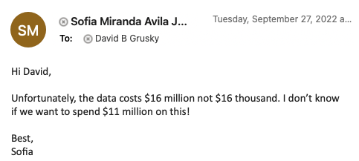
Data access
YOU GET FREE DATA
AND YOU GET FREE DATA
2020 - 2021: Data free for academics
2022: Move to Dewey, individual datasets become too expensive. Began an annual subscription model (~$1.9K per year)

Slide 6
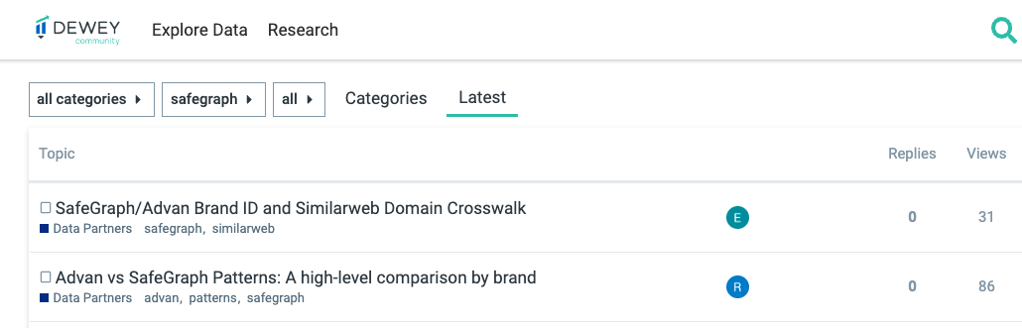
Dewey platform
Online marketplace to buy/download data
~24 hr approval
Not sure why this is the case
Community forum with good response rate

Slide 7
Datasets

Slide 8
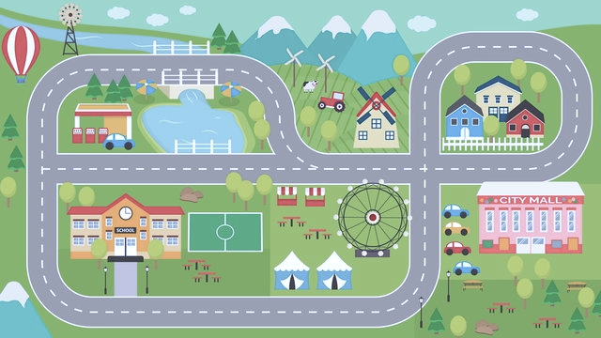
CBG data
Places data
Monthly patterns
(merged)

Slide 9
Core Places Data - Overview
Safegraph mission: “being the source of truth for physical places”
POI data sources:
Crawling e.g., a brand’s website that lists where all of its stores are or websites that list where all airports are.
Modeling to infer additional attributes (ex. inferring what category a POI is)
Licensing third-party data to fill in the gaps
For each state → thousands of “core places” tracked on a weekly basis
Big breadth of location types included. Restaurants and retail stores, parks, warehouses, EV charging stations, oil rigs, etc.
Surprisingly comprehensive: ~95% success matching Texas public schools
Documentation here

Slide 10
Core Places Data - Variables
Placekey: unique identifier for each POI
Parent Placekey (e.g., if a Starbuck is inside a mall)
4 and 6 digit NAICS code
Has been super useful for our work
Relevant geography:
latitude
longitude
address, etc
Square footage of POI + parent POI

Slide 11
Monthly Pattern Data - Overview
Core places data connected to foot traffic data (phone tracking)
Structure of data: One point-of-interest (POI) per row
Raw visitors + Raw visits
Total visitors per day
Popularity by hour
Median dwell time + bucketed dwell times
POI CBG (where POI located)
Visitor home cbgs
Median distance from home
See documentation here

Slide 12
Monthly Pattern Data - Notes
Visitors by hour not available
One approach: apply same time distribution to each day
Mobile phone data only sample of population
Scaling factor = Raw Visits * (State Population/Number of devices in SG sample)
Home assignment
Analyzing 6 weeks of data during nighttime hours (between 6pm and 7am).
“Sufficient amount of evidence to assign a home (common nighttime) for the device, which is then mapped to CBG and census tract”
Safegraph no longer maintaining foot traffic data. Historical data from 2018-2022 available.
Would suggest to download and store

Slide 13
CBG Data
Use CBG data (income, race, age, gender, etc) to assign relevant attributes to visitors
Many sources for CBG data (IPUMS, ‘acs’ R package, etc.)
Safegraph also provides clean ACS data that’s been very easy to use
5-year estimates from 2016-2020

Slide 14
Workflow

Slide 15
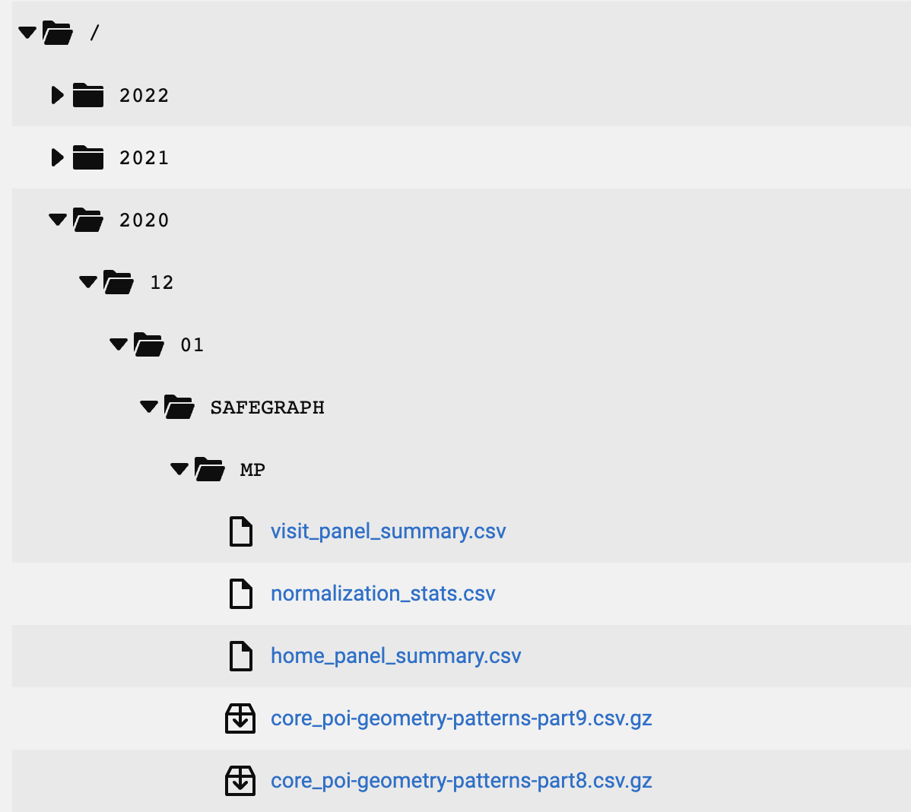
Downloading the data
Data files divided in monthly folders
All states
Split into ~30 parts
Size:
Each unzipped file: ~685 MB
All monthly data → 20 GB, 14M rows
Can’t query ☹
Instead, filter on Python and download what you need
State x month data is manageable (400MB, <500K rows)
Wrote code to do this, feel free to use!
Available on the repo

Slide 16
Access files via API
To use script, you’ll need own credentials:
https://community.deweydata.io/t/tutorial-how-to-access-files-via-the-api/26006
Retrieve base64 encoding
https://base64.guru/converter/encode/text
sofiaaj@stanford.edu:password
headers = {'Authorization': 'Basic <ENCODING HERE>'}

Slide 17





Using the data
Get a sample of data (~100 rows) and write code on Jupyter Notebook
Test speed and make sure everything works
Once code is in good shape, create python script
Submit job on Sherlock
Study results, create plots, apply models etc using R

Slide 18
Efficiency
Use timeit to test your code
Parallelization
Especially useful with Sherlock (more cores!)
Avoid loops, work with matrix operations and use Numpy when possible
Have other work to do (or sleep to sleep)
Submit jobs overnight, over the weekend, and make progress on other parts of the work
Jupyter Notebook examples on GitHub repo

Slide 19


Sherlock
Stanford’s computer cluster
Gives access to more computing power
Use “jobs” to request resources (time and memory) and run python/R/Stata scripts
Jobs scheduled optimally → Slurm
Sample job file on GitHub repo
Computer resources divided into partitions
David is on H&S, usually less busy
Buy partition (if need be!)

Slide 20
Using Sherlock
Request an account (if you haven’t)
Need a faculty sponsor
Edit scripts locally and upload to Sherlock account (more on next slide)
Create an .sh File
The .sh file is how you will define your job and resource request to sherlock
Submit job
Cheat sheet available GitHub repo
Sherlock documentation

Slide 21
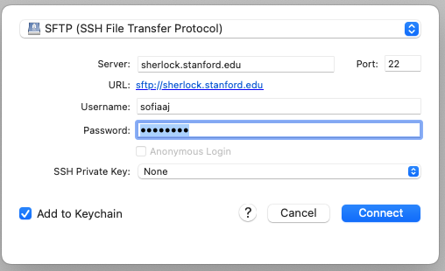
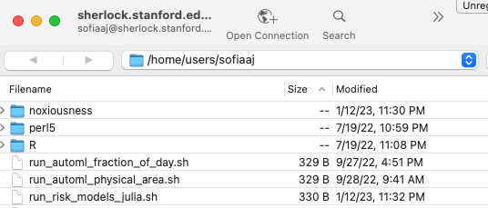
Sherlock & Cyberduck
Provides a GUI for file system on Sherlock
Easily transfer files
Edit code files using preferred editor
Log in:
Open connection > SFTP (SSH File Transfer Protocol)
Server: sherlock.stanford.edu
Username: <sunet ID>

